Slide 1
EDA on Facebook Users
Kasturi Sahu

Slide 2
Prelude
Facebook, a social networking site, is used exchanging information, ideas, marketing and selling products. We shall study the dataset available to understand how are the trends in the following:
Distribution of users
Various activities by users
Understand patterns across genders, age groups and tenure of the users
Actionable areas

Slide 3
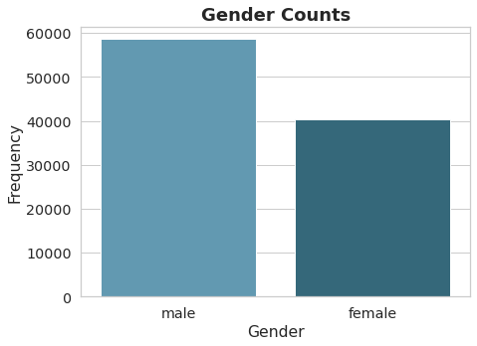
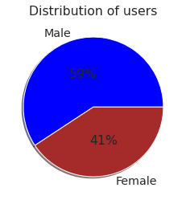
Users Gender Distribution
It’s a 60:40 ratio wherein male users have more facebook accounts than females.

Slide 4
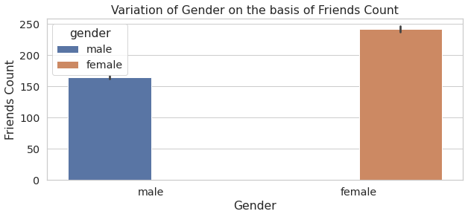
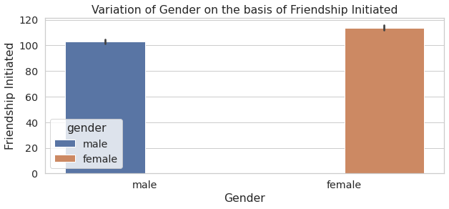
Gender wise Friends Count
Not only females have more friends count but females have initiated more friend requests than males.

Slide 5
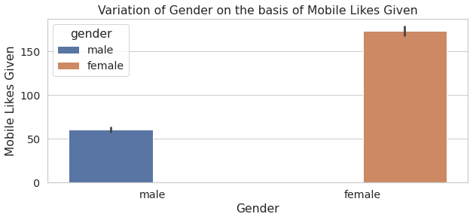
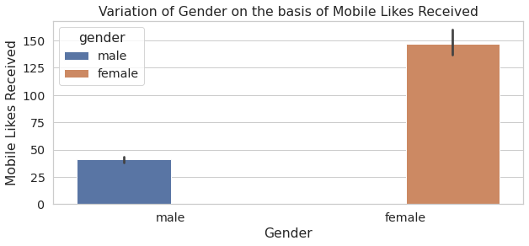
Gender wise Mobile likes
Female users use facebook on mobile phones more than males.

Slide 6
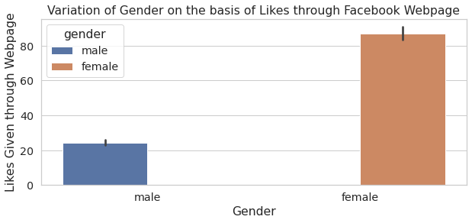
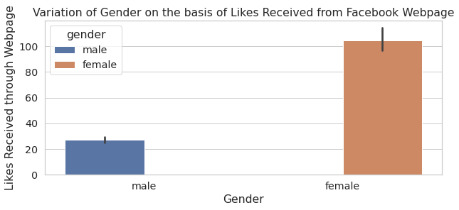
Likes through webpage
Trend remains same as it was with likes through mobile.

Slide 7
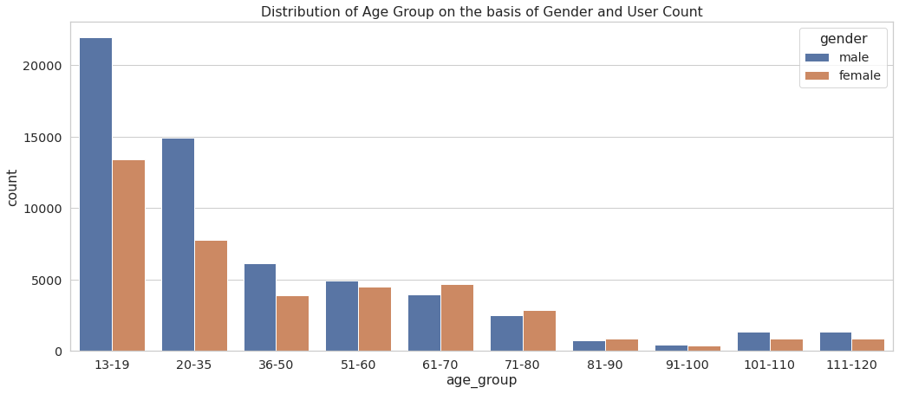
User distribution basis Age group
Majority of users are teenagers followed by young brigade between the age group of 20 to 35 years.
Ratio of female users superseding male users observed in age group 61 to 90 years.

Slide 8
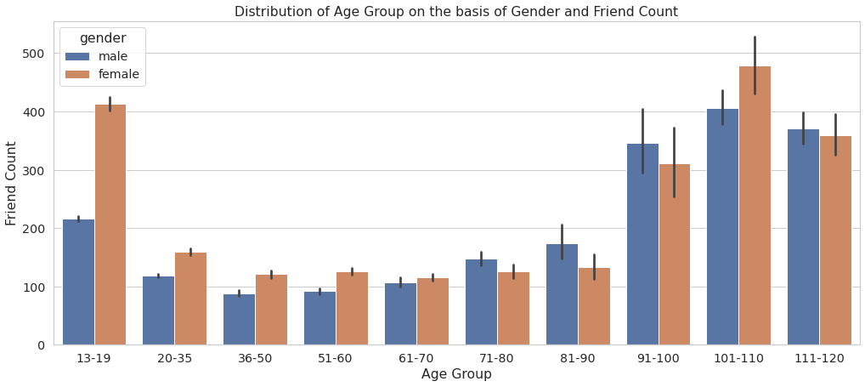
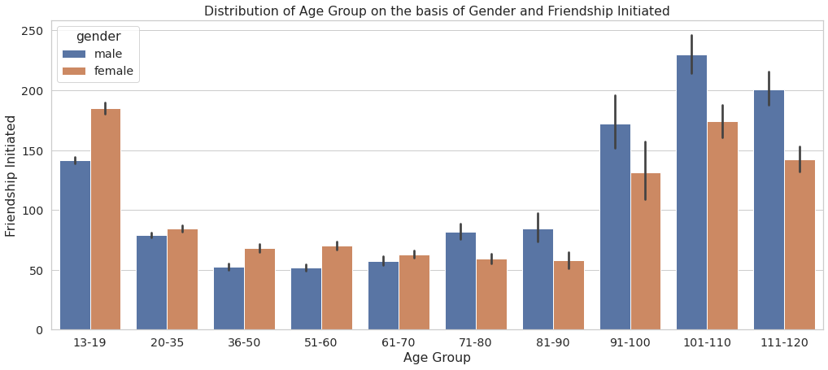
Friend Count and Request initiated – Age group wise
Males initiating friend requests supersedes females observed in the age above 71 years.
Both friend count and friendship initiation request is high in the age group up to 19 years and between 91 to 120 years.

Slide 9
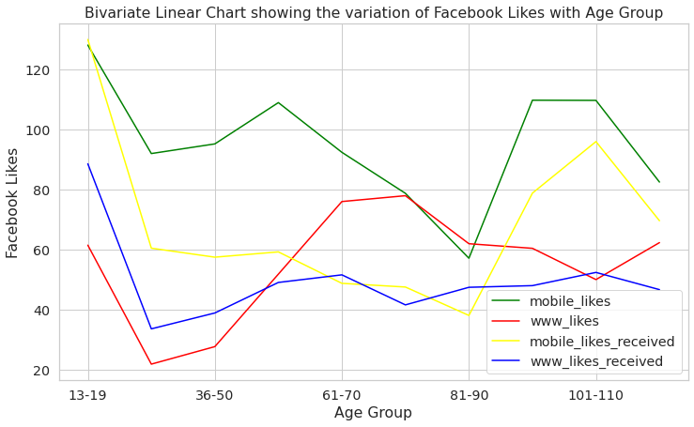
Age wise likes given and received
Increasing trend observed in giving and receiving likes between age groups 36 to 80 years. However, this trend is not true for likes received through mobile.
Spike in likes through mobile observed post the age of 80 years.

Slide 10
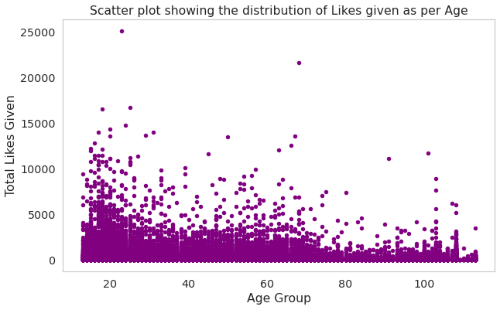
Trend of likes given as per Age
Spike in likes given post the age of 80 years is due to few outliers.

Slide 11
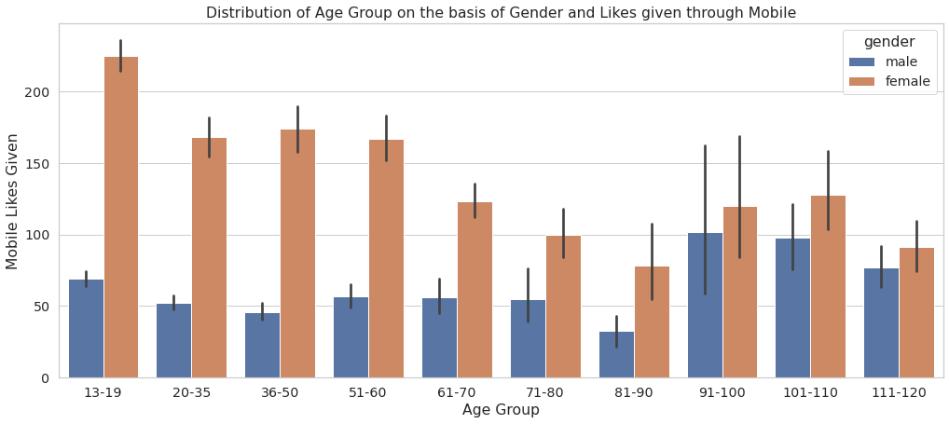
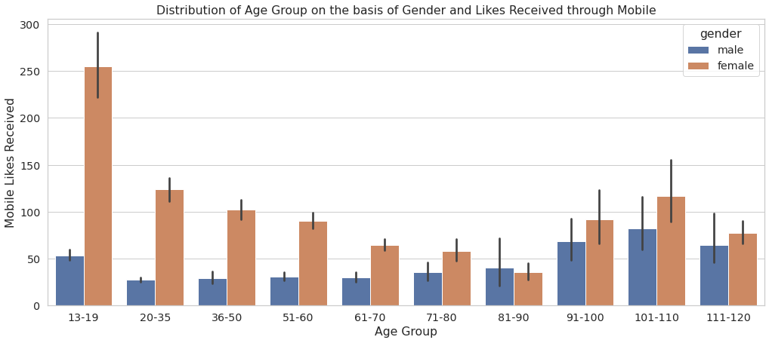
Likes given and received through Mobile – Age group wise
Majority of likes given and received is highest amongst the teenagers.
Likes given were almost same for the female users of age group between 20 to 60 years.

Slide 12
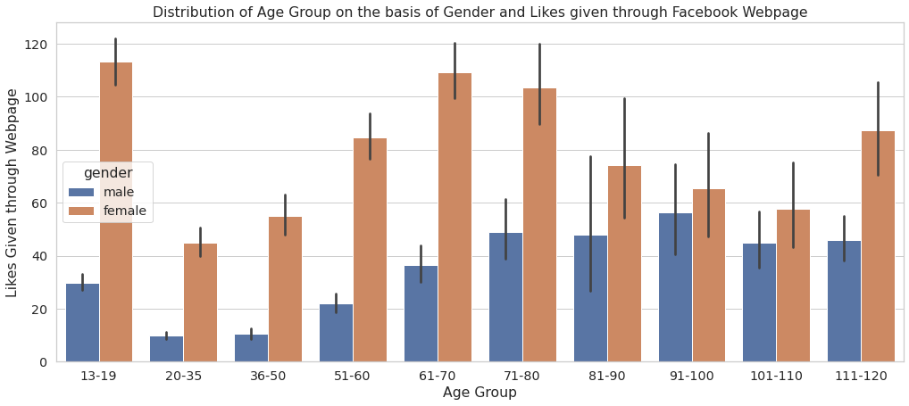
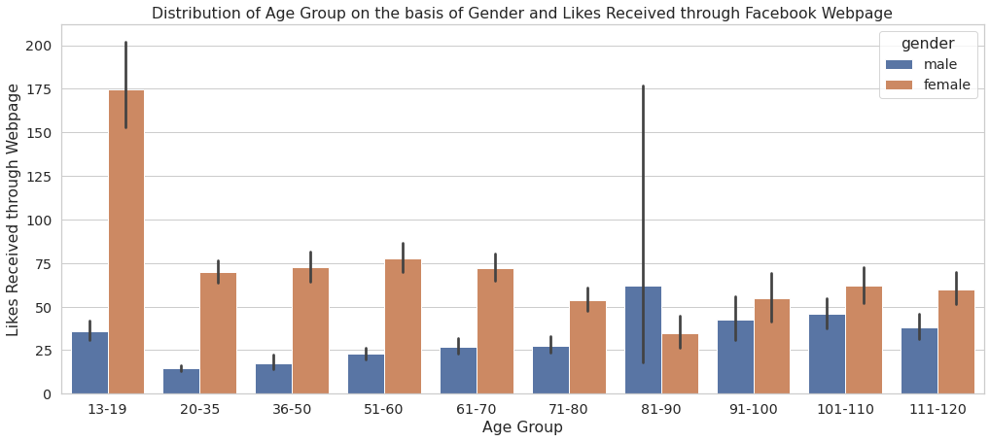
Likes given and received through webpage – Age group wise
Majority of likes received is amongst the female teenagers
Increasing trend in likes given and received by female users

Slide 13
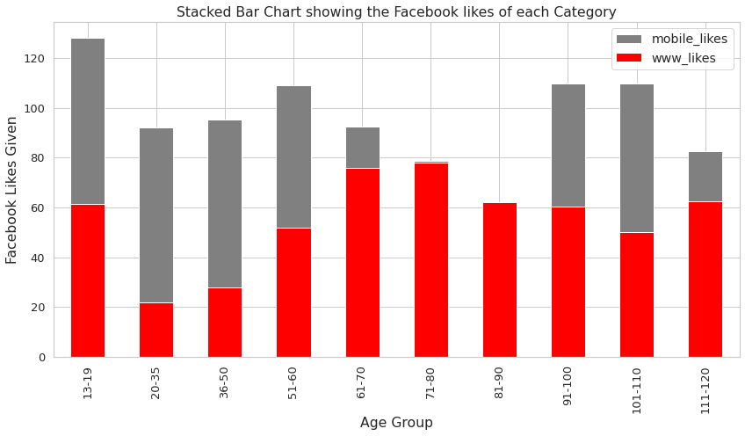
Likes given through Mobile vs. Webpage
While mobile is used frequently by young users, the mobile usage for giving likes decreases between age group 60 to 90 years.

Slide 14
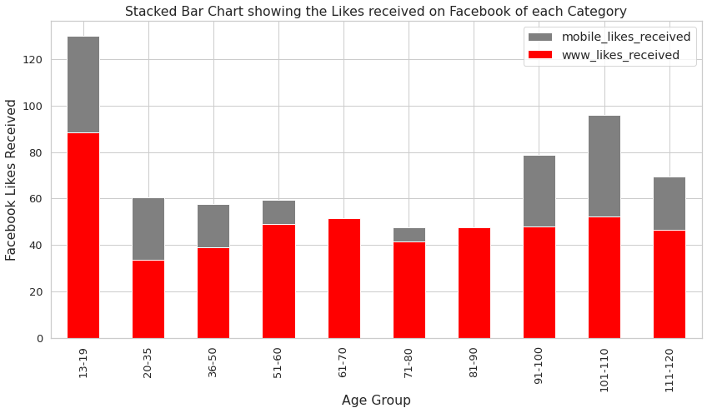
Likes received Mobile vs. Webpage
The ratio of mobile likes received to that through webpage decreases as the age increases, until the age of 90 years.

Slide 15
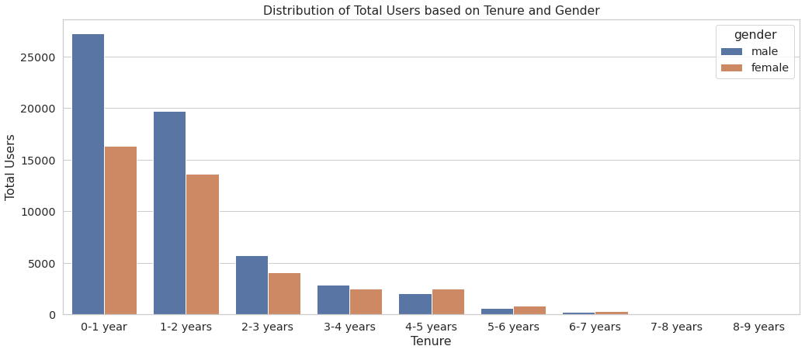
User distribution basis Tenure
Majority of users are new and have their account since 2 years.
More female users found having account above 4 years, as compared to male users.
Drastic fall in male user accounts as tenure grows.

Slide 16
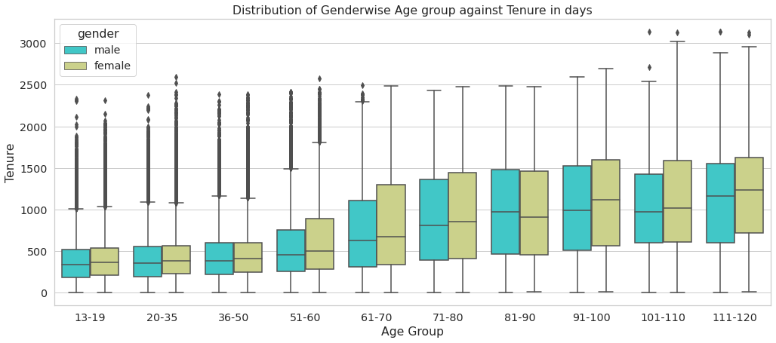
Gender wise distribution of Age group and Tenure
Tenure of users has an increasing trend with increase in age across both genders.

Slide 17
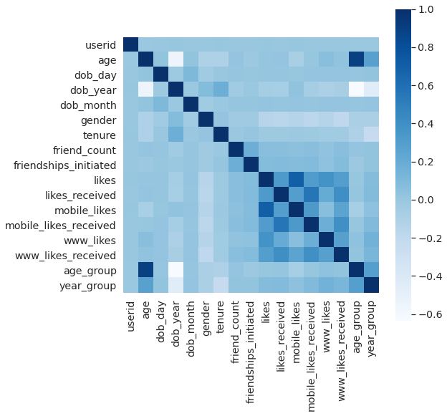
Correlation of Features
Friend Count and Friendship initiated are correlated to each other.
Same with Likes given and Likes received, Mobile likes given and received, Webpage like given and received.

Slide 18
Conclusion and Actionable
Conclusion:
While there are more male user accounts, female users (especially teenagers) seem to be more active on facebook
Users have a tendency of using facebook over mobile at younger age and over webpage as age grows
Increase in activities observed in age group between 51 to 80 years
More male user accounts become inactive as the tenure grows
Actionable:
Market more female oriented products
Market more products, educational material for teenagers
User Interface of facebook can be more mobile friendly so that more users can use it on mobile phones
Monitor activities of users between age group of 51 to 80 years and market products accordingly
Some schemes (long term association points: redeemable against purchasing some product) can be introduced to increase the retention ratio of users (especially male users)

Slide 19
Thank You

